Slide 1
Lab Course - Cloud Architectures and Management, Summer '15
Assignment 3
Felix Ebinger, Thomas Reinhardt, Julian Ziegler

Slide 2
Task 1 - Deploy WordPress using AWS CloudFormation (1)
Part 1 → WordPress basic single instance (point and click adventure :) )
Part 2 → Extentsion of template of part 1. Define 2 AWS::EC2::Instance (Wordpress & MySQL)
See files !

Slide 3
Task 1 - Deploy WordPress using AWS CloudFormation (2)
Script loads template to CloudFormation and triggers start
01 #!/usr/bin/env sh
02
03 # Script for automatic deployment of our Wordpress/MySQL EC2 instances.
04
05 aws cloudformation create-stack \
--stack-name Group2-WordPress-MySQL-DEMO \
--template-body file://wordpress_mysql.json \
--parameters \
ParameterKey=DBName,ParameterValue=wordpressdb,UsePreviousValue=false \
ParameterKey=DBUser,ParameterValue=wordpress,UsePreviousValue=false \
ParameterKey=DBPassword,ParameterValue=123456789,UsePreviousValue=false \
ParameterKey=DBRootPassword,ParameterValue=123456789abc,UsePreviousValue=false \
ParameterKey=KeyName,ParameterValue=Cloud_FaPra,UsePreviousValue=false \
--timeout-in-minutes 10 \

Slide 4
Task 2 - Deploy WordPress using Juju (1)
Script bootstraps environment and deploys services
01 juju bootstrap --environment amazon
02 juju deploy wordpress
03 juju deploy mysql
04 juju add-relation wordpress mysql
05 juju add-unit --num-units 1 mysql
06 juju expose wordpress

Slide 5
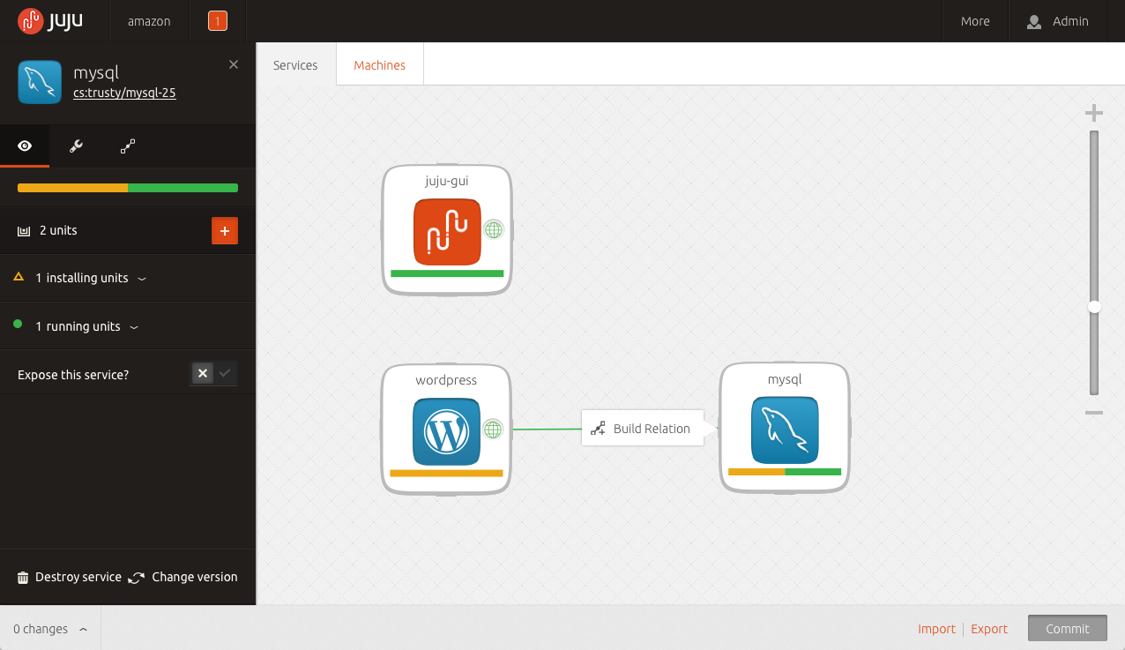
Task 2 - Deploy WordPress using Juju (2)

Slide 6
Task 3 – Deploy Moodle using OpenTOSCA (1)
Winery deployed - Topology of Moodle

Slide 7
Task 3 – Deploy Moodle using OpenTOSCA (2)
Didn‘t work
We tried:
CloudformationTemplate from Tutorial
Shell-Script from Tutorial (Unstable & Stable)
Moodle.csar finish deployment in Webinterface but error.log tells different story
Instantiation of moodle fails with endless loop (no noticeable progress)
Anyone else had similar problems? → Mailing-List?

Slide 8
Task 3 – Deploy Moodle using OpenTOSCA (3)

Slide 9
Task 4 – Deploy WordPress using OpenTOSCA
Idea (not tested, only assumptions):
Reuse almost everything of Moodle.csar! (LAMP-scripts)
Hack scripts to install and configure Wordpress Change code to install WordPress instead of Moodle (lazy)
Change DB configuration to adapt WordPress
Install and configure WordPress with new user data and DB-link
Reconfigure build plan (BPEL) to use new scripts & Target
Process for installing WordPress is identical to Moodle (conceptual)
Change ID and references to used scripts in process flow
Refactor MetaData of csar to represent WordPress
→ Add WordPress.tar.gz

